Slide 1
SIMULATION
PROJECT
BY :- AKSHAT KAKKAD
R.NO:-91900133038

Slide 2
VARIABLE SIGNAL
GENERATOR USING LM 317 IC
A DC OUTPUT OF
1.25-15 V

Slide 3
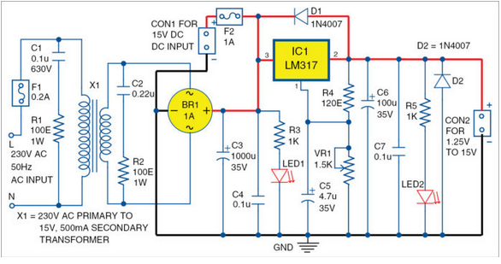

Slide 4
SOMETHING ABOUT LM 317...!!
The LM317 is a popular adjustable positive linear voltage regulator. It was designed by Robert C Dobkin in 1976 while he worked at National Semiconductor.
It gives us a desired outcome of DC voltage from 1.25 V to 45 V.
Here we will simulate a circuit which will give us an output from 1.25V to 15V.

Slide 5
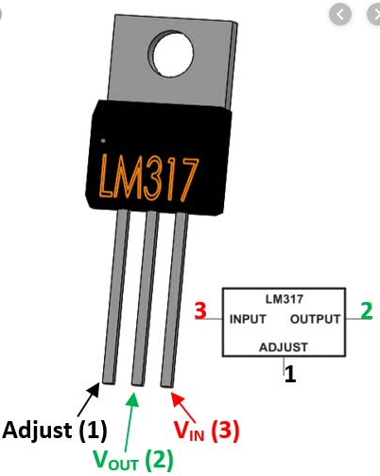
ADJUST PIN :- Connected to variable Resistor so we can get variable DC output.
OUTPUT PIN :-
Gives the output
voltage to us .
3. INPUT PIN :-
Takes input from the supply .

Slide 6
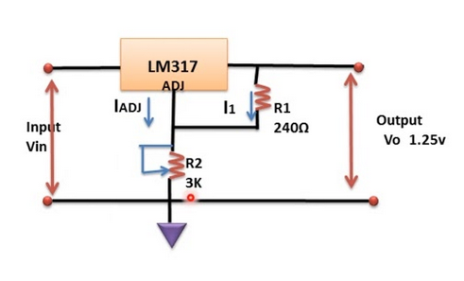
CIRCUIT...!!!

Slide 7
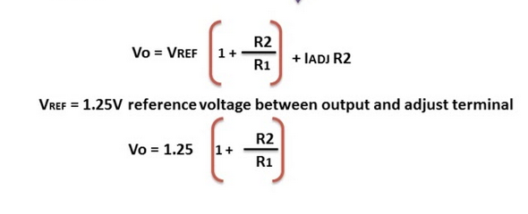
@EQUATION

Slide 8
##LET’S DO SOME
SIMULATION##

Slide 9
$$TROUBLESHOOT$$
In simulation if we have connected transformer as a power supply then we do not need to connect external battery . As if external battery is connected then there will be two inputs and as a result this will disturb our output.
We must take care of drop of diodes as well as LED’s connected and set the turns of transformer accordingly.

Slide 10
ACKNOWLEDGEMENT
Guided by :- C .D. Parmar sir
(HOD) B.Tech ICT.
Marwadi university,Rajkot.
Ref site :- www.Electronics for u.com
You tube :- Learn and Grow.
Ref book :- Electronic Devices & Circuit Theory.
By:- Robert L. Boylestad.

Slide 11


